Slide 1

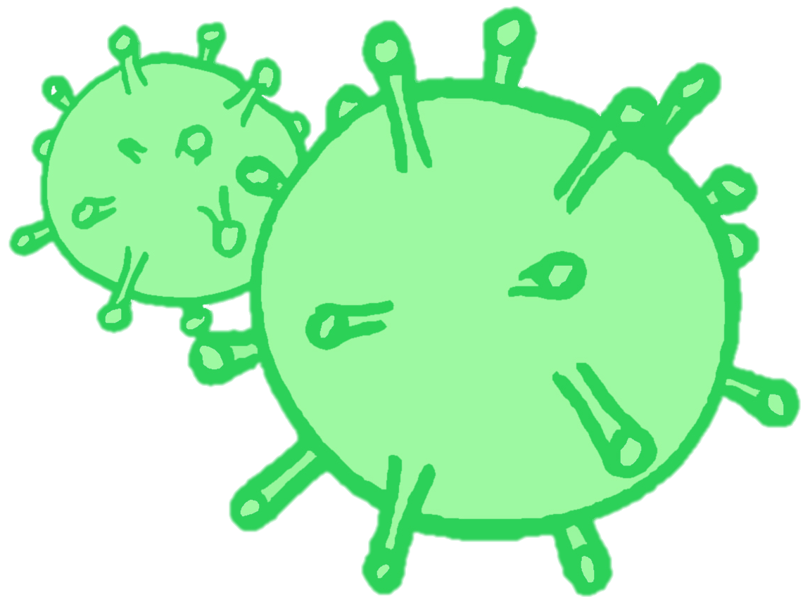
CONTRACEPTION & STI’s
Year 10 Health Lesson 2 + Lesson 3 Term 2, 2024

Slide 2

Today’s Focus
List reasons why people choose to use/not use contraception.
Consider reasons to postpone sexual intercourse.
Define the different types of contraception.
Be introduced to the different methods of contraception.
Revision.

Slide 3
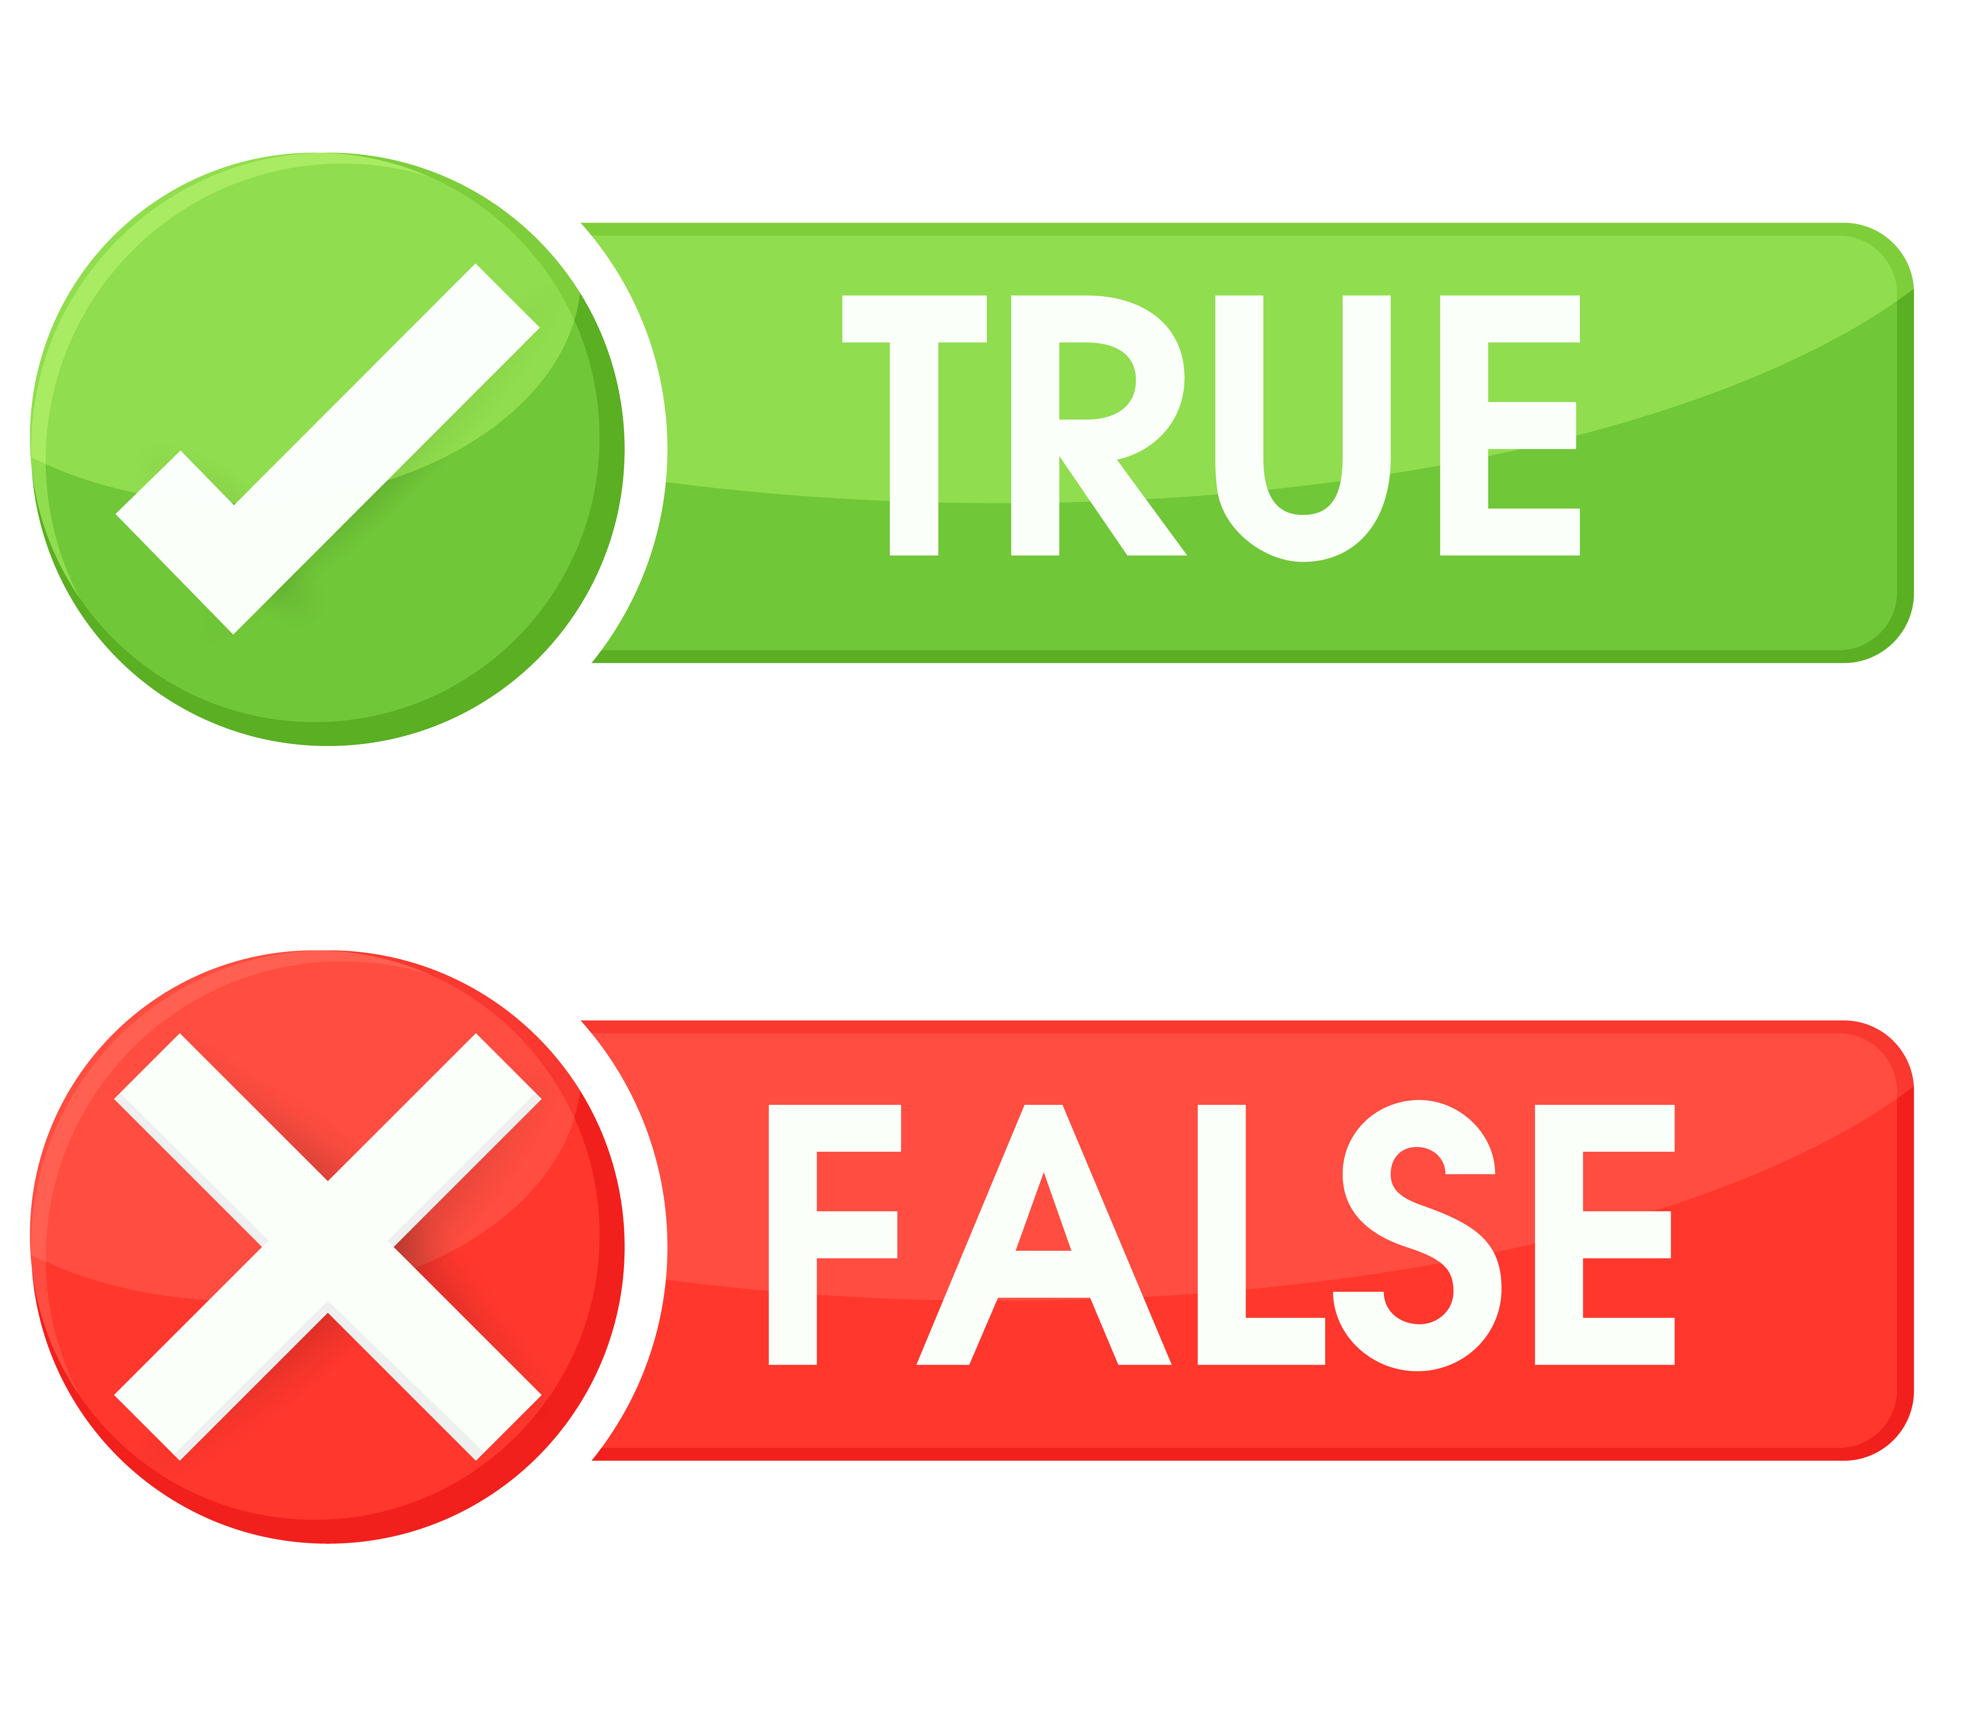
OPTIONAL HOOK: TRUE OR FALSE (pg. 12)
OPTION 1:
Students complete the questions in their books (3 minutes).
Go through answers as a class.
OPTION 2:
Teacher to read out the statement.
Students stand with TWO HANDS on their HEADS if they think the statement is TRUE.
Students stand with TWO HANDS on their TAILS if they think the statement is FALSE.
Notes:
OPTIONAL
Choose which option you prefer.
Statements are found in the student/teacher workbook.

Slide 4
OPTIONAL Hook: (pg. 13) Reasons to Postpone Sex
Reasons TO HAVE sex: | Reasons NOT TO HAVE sex:
There are a wide range of reasons why a person would choose to engage in sex, choose to not have sex or wait.
Consider these reasons by completing the T-chart in your workbooks.
Be prepared to share.
You have 5 minutes.
Curious
To fit in
Peer Pressure
In love
Want children
Don’t want kids
Don’t want an STI
Religious reasons
No one to have sex with
Don’t want to get in trouble
Illegal (underage)
Notes:
Relevant to test (but was covered in Lesson 6 & 9, T1 P.P.)

Slide 5
Types of Contraception (pg. 14)
There are 5 types of contraception for us to consider:
Barrier – puts a barrier between the penis and the vagina and stops the sperm from meeting the egg.
Hormonal – regulates or stops ovulation and so preventing pregnancy.
Natural – doesn’t involve any kind of barrier or chemical etc. Natural methods of birth control.
Emergency – used immediately after sex to prevent fertilisation.
Surgical – sterilization; surgical procedure to control pregnancy/birth control.

Slide 6

Notes:
OPTIONAL – 4 mins
Funny video: Rachel comes over to tell Ross that she is pregnant with his baby, due to a contraception failure. Ross freaks out and tries to call the condom company and tell them off.
Discussion points:
Effectiveness: no method (other than abstinence) is 100% effective in preventing pregnancy.
Always check the use by date on condoms.
Condoms can split or fall off during intercourse. If this happens and ejaculation occurs, then the female will need to consider the use of the emergency contraceptive pill as a back up.
Emphasis on being careful as it can only take one time to get pregnant.
Discuss impacts of unplanned pregnancy: financial impacts (cost of appointments, raising a child etc.), physical health for the female, stress, work implications etc. (relevant to test)
https://www.youtube.com/watch?v=biZEstQVD24

Slide 7
Activity 2: Methods of Contraception (pg. 14-16)
The IDEAL contraception would be:
Safe
100% effective
Free of side effects
Easily obtainable
Follow along with the information in the upcoming slides to complete your table in your books on the METHODS of contraception.
But unfortunately, this is not always possible to achieve. Just as every person is different, everyone may react differently to different forms of contraception, and have different reasons for use. There are a wide range of contraceptives available to try and accommodate for all.
Affordable
Acceptable to the user and sexual partner
Free of effects on future pregnancies
Notes:
The following slides will cover all the different methods of contraception. Using the information in the slides, students need to fill in the missing information in their tables in their books.
If time is an issue: use your best judgement and check against the test and pick the most relevant methods to focus on to allow you to get through enough content during lessons 2 & 3.
At the end of the contraceptive methods slides there are various optional activities which can be used as revision.
Be sure to hand out revision at the end of lesson 3 in preparation for the topic test during lesson 4.
**Vaginal Ring and Contraceptive Patch are in the PP, but not in the table in their books. Still speak about these methods using the slides.

Slide 8
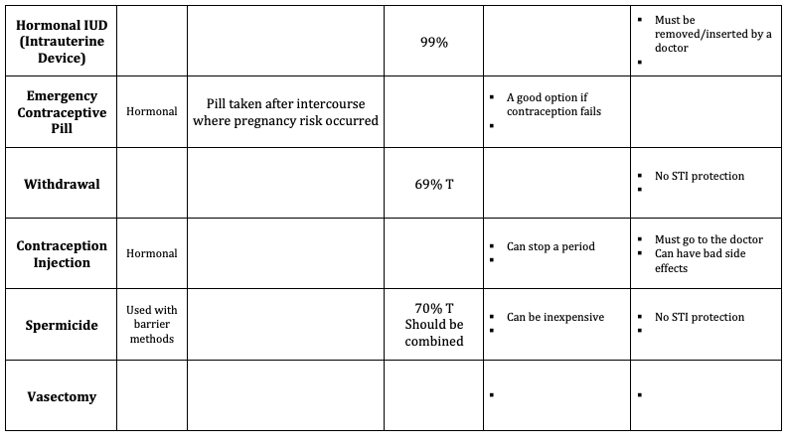
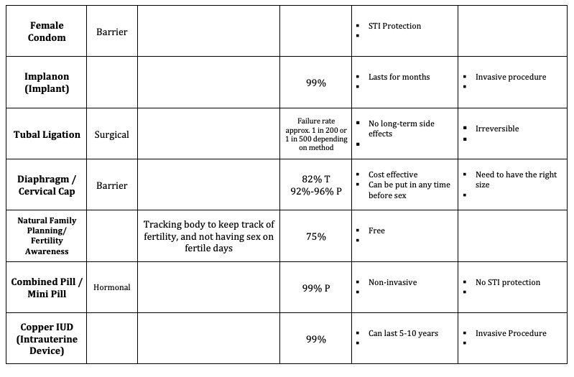
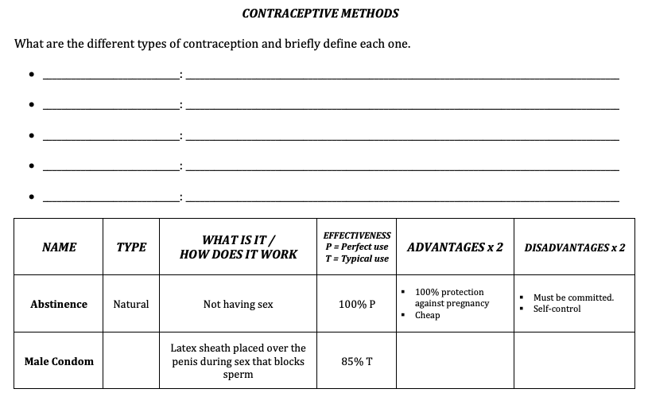
Activity 2: METHODS OF CONTRACEPTION (pg. 14-16)
As you move through to complete the tables and as each method of contraception is discussed, don’t forget to consider the advantages (pros) and disadvantages (cons) of each method.

Slide 9
IMPORTANT!
As we talk through this unit on sexual health, it is important to acknowledge that no two people are the same.
Just as we all have different hair colour, skin colour, facial features etc., penis and vagina also vary greatly in shape, size and colour.
As with contraceptive methods – everyone has their own preferences for various reasons (i.e., cost, ease of use, length of effectiveness, fit and comfort level etc.) and everyone will react differently or have different side-effects (particularly for hormonal methods). This is also why there are so many options available.
There is no one perfect penis, vulva or method of contraception.

Slide 10
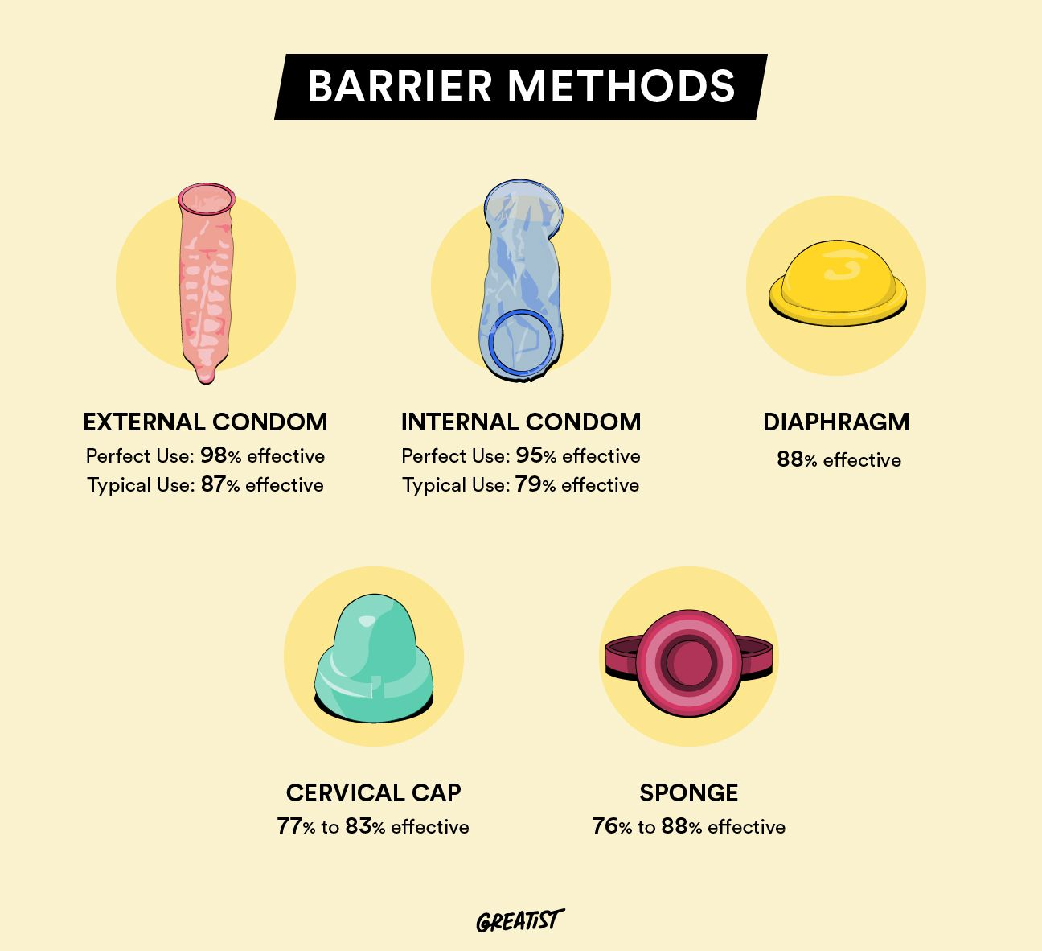
BARRIER METHODS:
Male condom (external)
Female condom (internal)
Diaphragm & Cervical cap
Spermicide

Slide 11
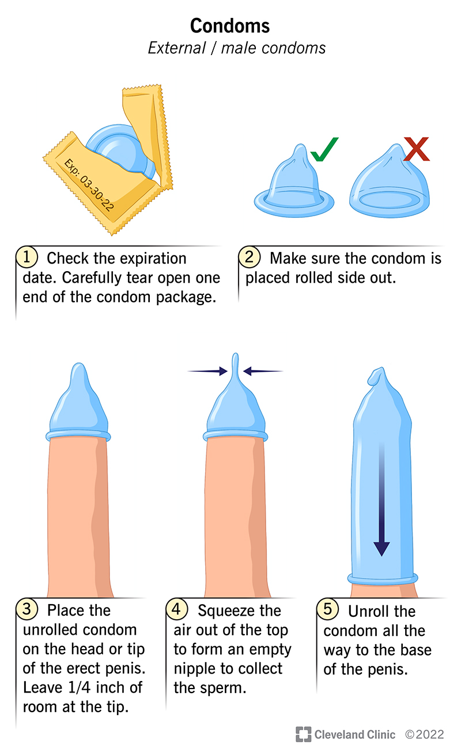
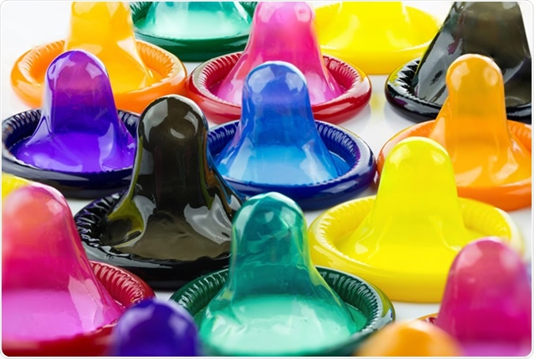
Male Condom
Only method of contraception boys can use.
It's really just a rubber, latex tube.
It's closed at one end like the finger of a glove so that when a boy puts it over his penis it stops the sperm going inside a girl's body.
It is a barrier method of contraception as it provides a barrier between the penis and the vagina and avoids any skin-to-skin contact.
Easily accessible.
94 – 98% effective if used correctly.
STI prevention.

Slide 12
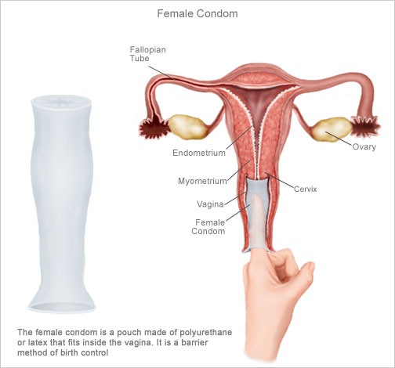
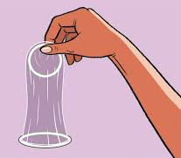
FEMALE CONDOM
Not as widely available as the male condom and is more expensive.
The closed end gets inserted into the vagina, and the penis enters through the open end.
It also puts a barrier between the penis and the vagina and therefore, prevents sperm from entering the female body.
95% effective if used correctly.
STI prevention.

Slide 13

What you need to know about Condoms:
Notes:
OPTIONAL
2:52mins
https://www.youtube.com/watch?v=hNcDm37yj5Q

Slide 14
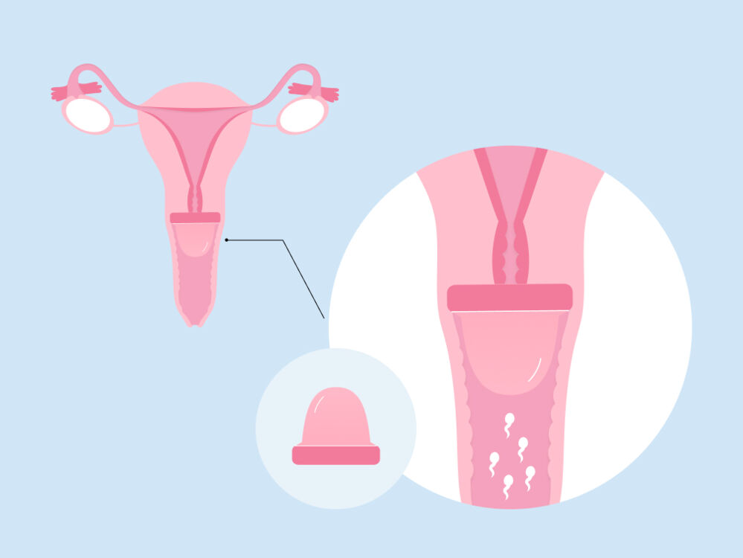
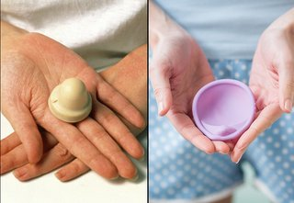
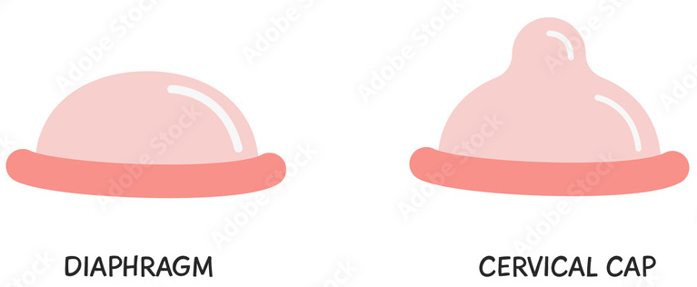
DIAPHRAGM & Cervical Cap
Puts a barrier covering the cervix so that sperm cannot enter the uterus.
A shallow dome of silicone with a firm, flexible rim.
Must be left in place for at least 6 hours after sex.
92% – 96% effective when used perfectly and with a spermicide.
Does not prevent STI’s.

Slide 15
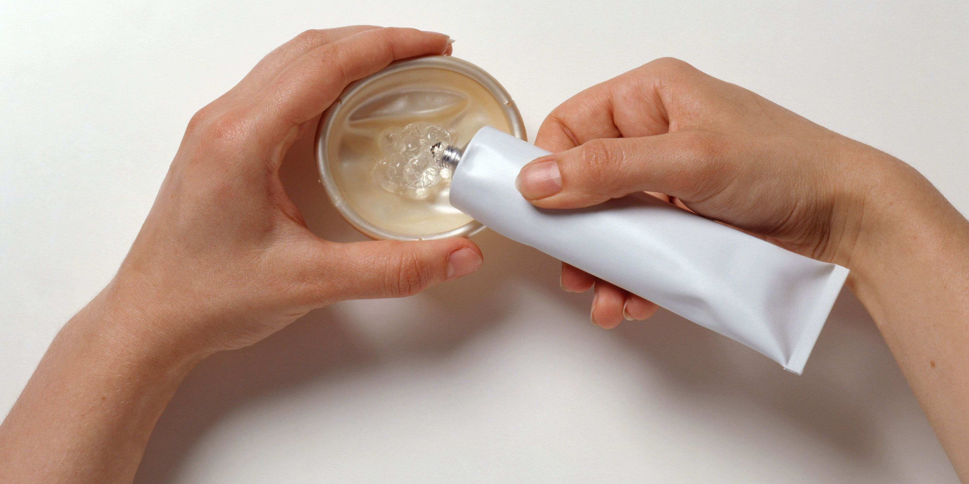
SPERMICIDE
Come in several different forms: cream, gel and foam.
Most spermicides contain nonoxynol-9, a chemical that blocks the sperm.
Up to 70% effective on their own. Can be inserted into the vagina.
Spermicides can be used alone but are more effective when used with another method of birth control, such as a condom or diaphragm.
Very little side effects.
Must follow instructions properly.
Does not prevent STI’s.

Slide 16
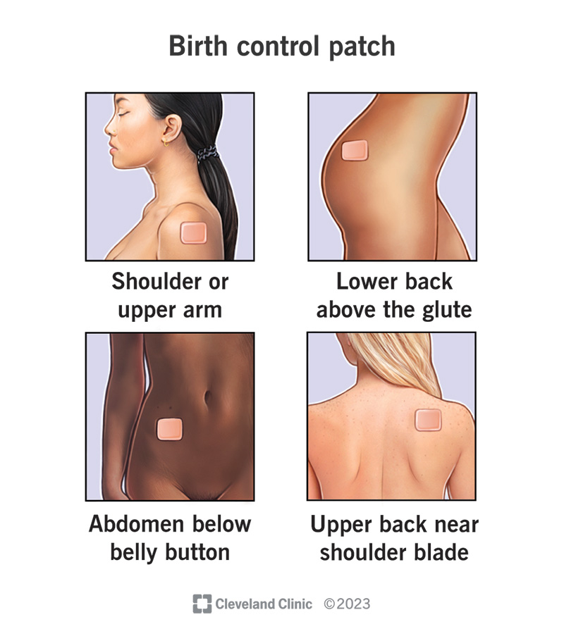
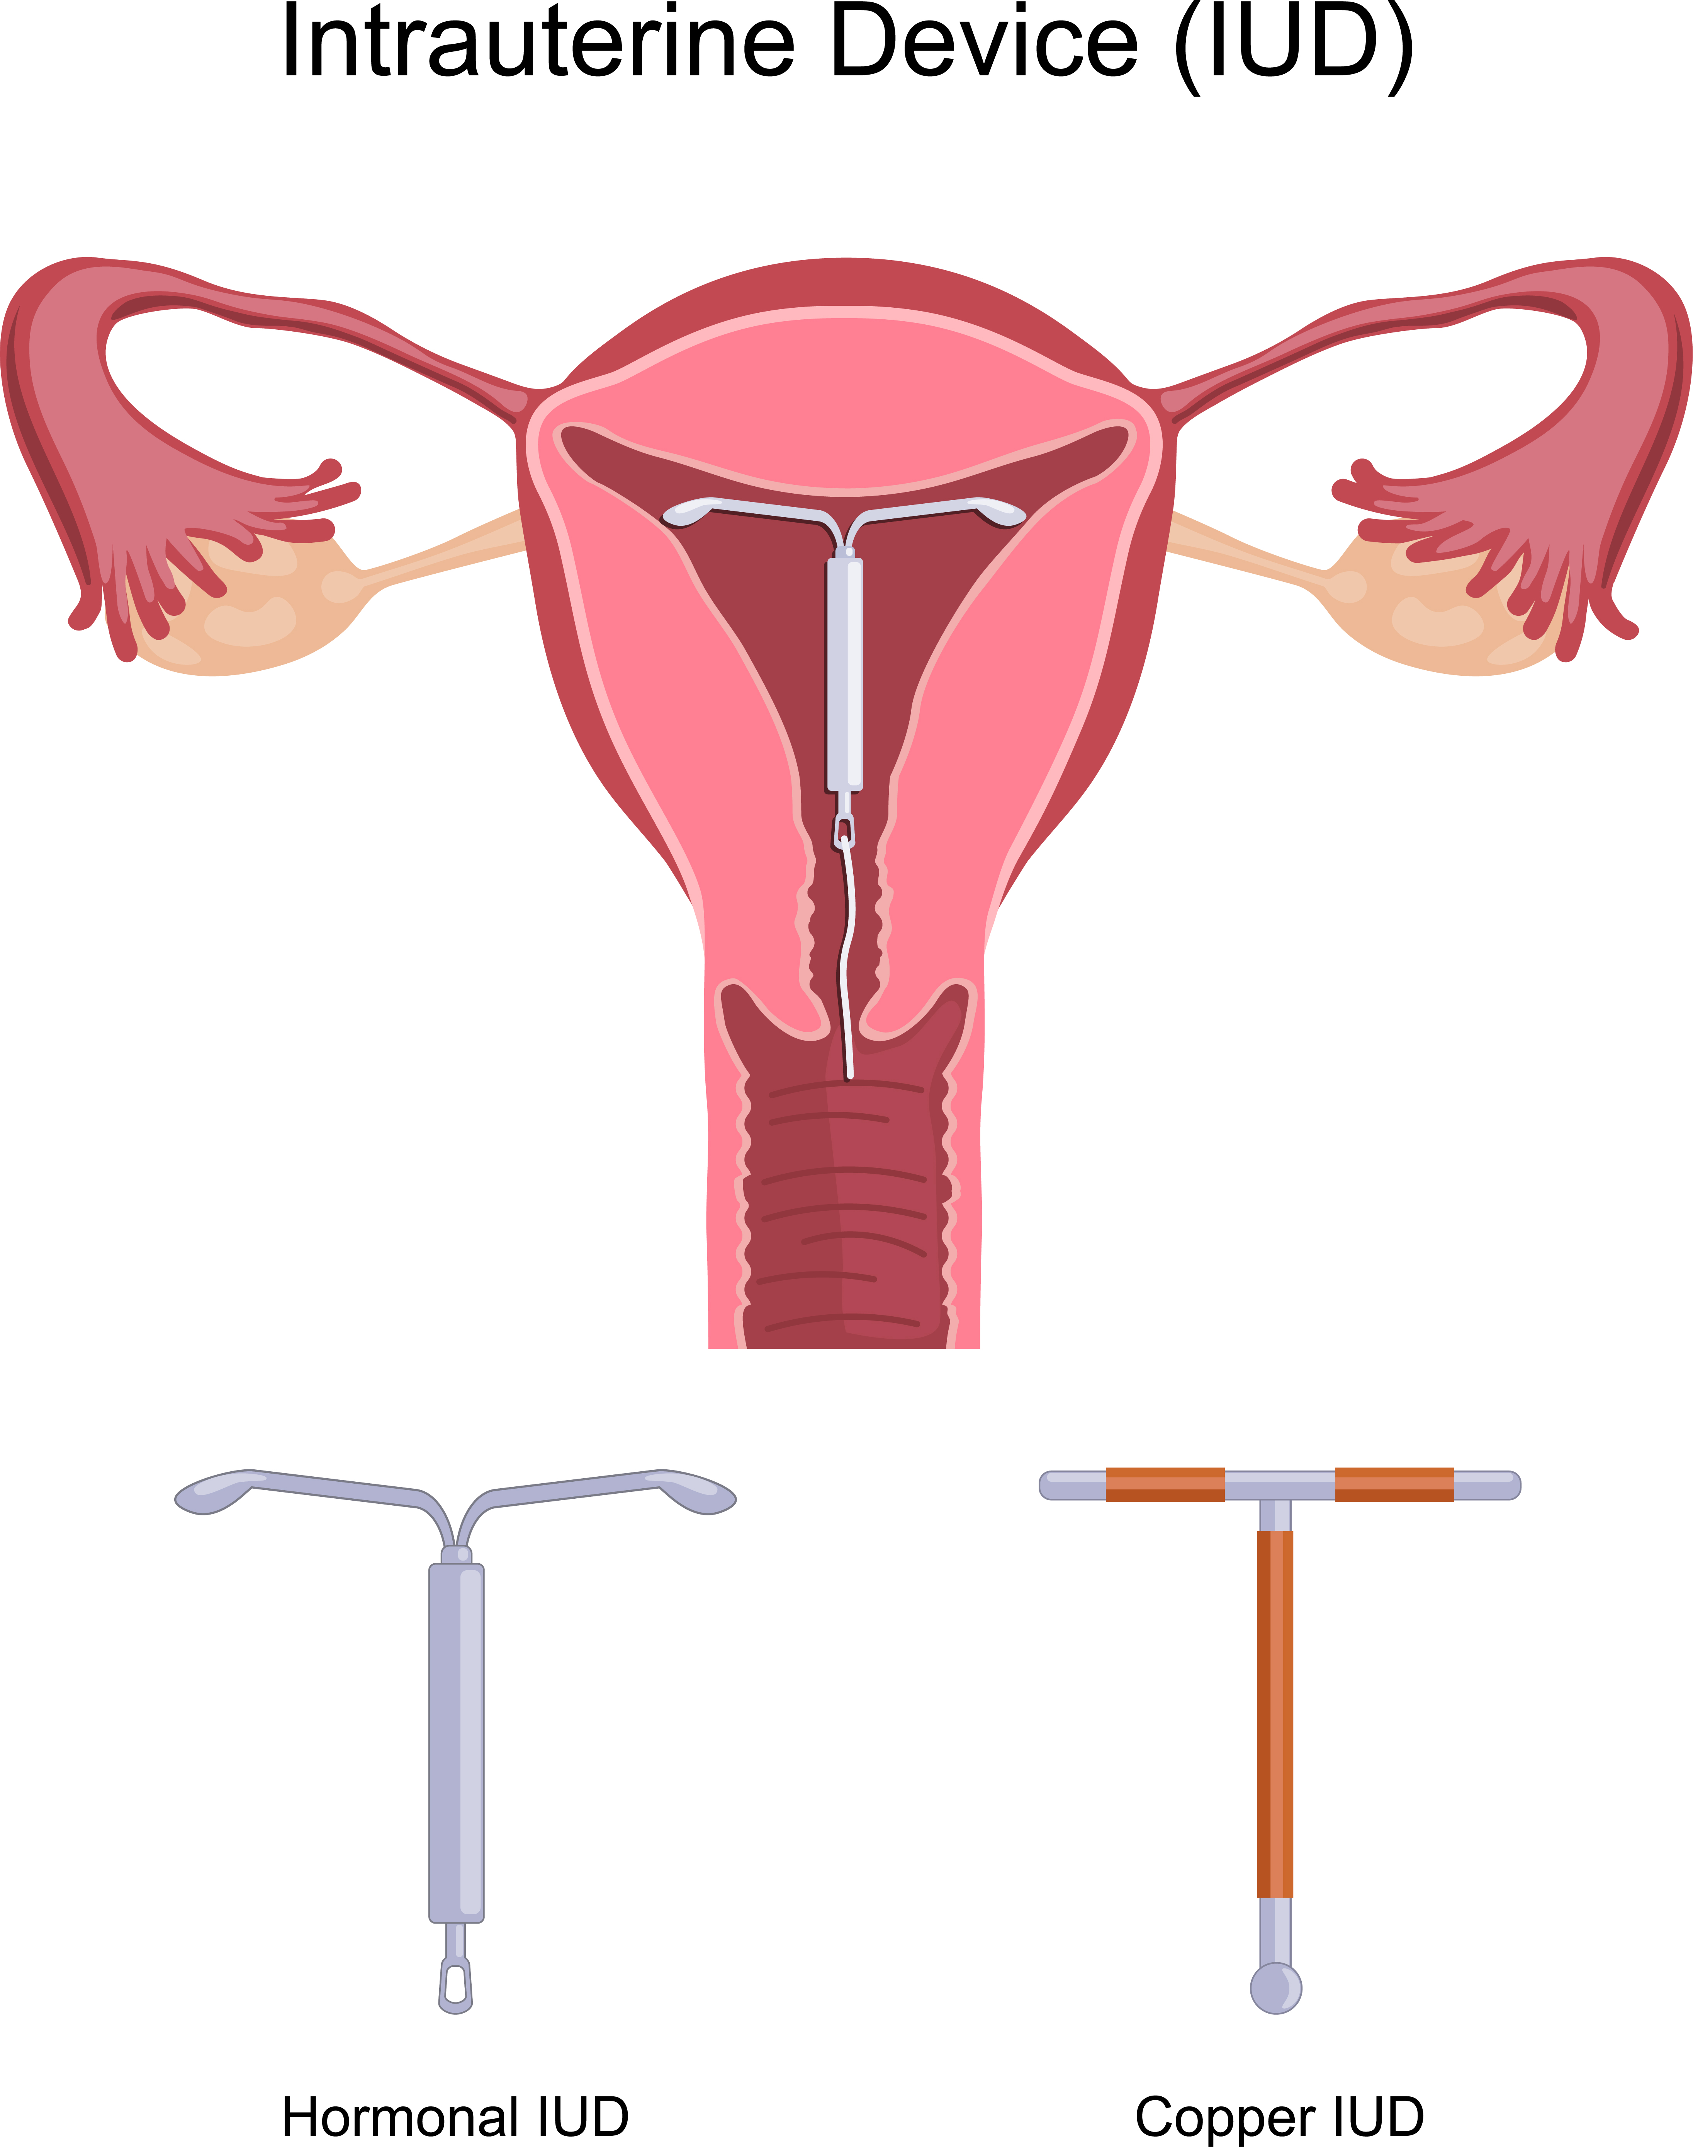
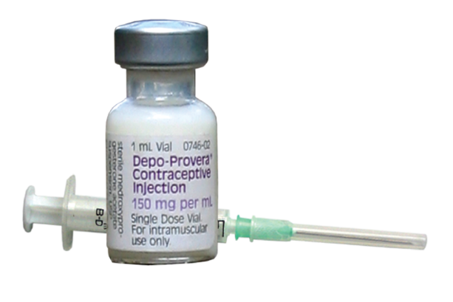
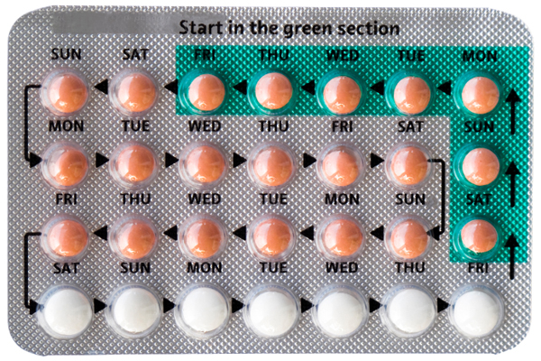
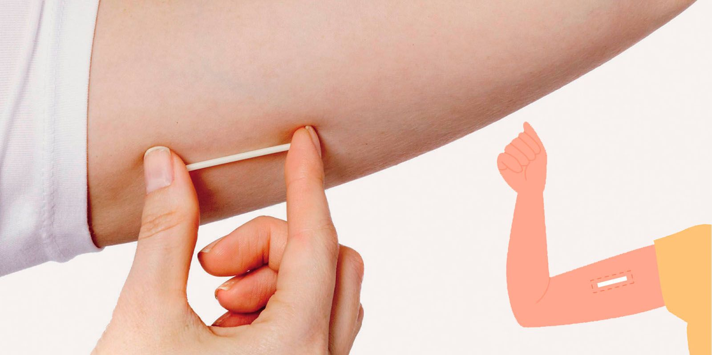
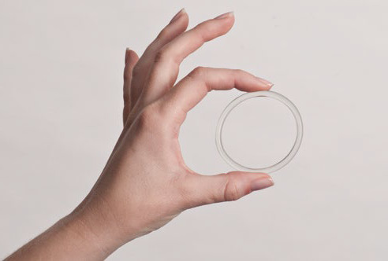
HORMONAL METHODS:
IUD – Copper (non-hormonal) or Plastic (hormonal)
Patch
Implanon/Rod
Injection
Vaginal Ring
Pill – Combined & Mini

Slide 17
Copper IUD
IUD = Intra-Uterine Device.
T shaped device with fine copper wire wrapped around the frame.
Placed inside the uterus.
Toxic to sperm which prevents fertilisation, slows the movement of sperm and changes the lining of the uterus to prevent implantation.
They can last for 5 – 10 years (Long Acting Reversible – LAR method)
Side effects may include infection, uterine wall damage, heavier and longer periods, irregular bleeding.
It needs to be inserted and removed by a medical professional.
Can be used as an emergency contraception if inserted up to 5 days after unprotected sex.
99% effective.
Does not prevent STI’s

Slide 18
Hormonal/Plastic IUD
IUD = Intra-Uterine Device.
A small T shaped plastic device with a hormone (levonorgestrel) in the stem.
Placed in the uterus.
Stops fertilisation and makes the mucus thicker so the sperm can’t swim to the egg.
Changes the uterine lining so implantation cannot occur.
Lasts for 5 years (LAR method).
Side-effects may include bloating, headaches, mood changes, acne, lower sex drive, irregular bleeding or spotting.
It needs to be inserted and removed by a medical professional.
99% effective.
Does not prevent STI’s.

Slide 19
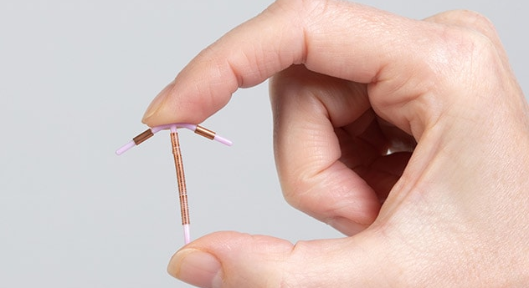
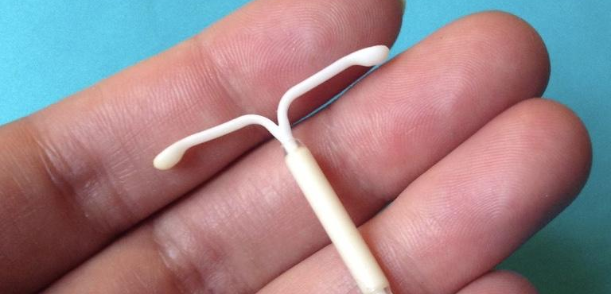

Slide 20
Patch
Contains hormones – oestrogen and progesterone (same as the combined pill).
Worn on the skin like a band-aid.
One patch is worn for a week at a time, for 3 weeks. The 4th week it is not worn, and menstrual bleeding will occur.
Releases hormones into the body that prevents ovulation from occurring.
Thickens cervical mucus, preventing sperm from reaching the egg.
Less serious side-effects may include spotting, irritation, menstrual pain, headaches, mood swings, weight gain, mood swings, blood clots etc.
Perfect use = 99% effective, typical use = 93% effective.
Does not prevent STI’s.
Notes:
NOT INCLUDED IN THE TABLE IN THEIR BOOK.

Slide 21
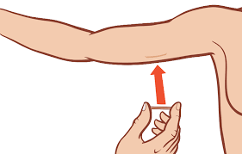
IMPLANON (ROD)
A small, thin, flexible 4cm rod that’s inserted under the skin on the inside of the upper arm.
Continuously releases small amounts of a progesterone hormone that prevents ovulation and thickens the cervical mucus.
Can be left in for up to 3 years.
Must be inserted and removed by a medical professional.
Side-effects may include a change in menstrual bleeding (irregular or stopping), headaches, skin changes, tender breasts, mood swings.
99% effective.
Does not prevent STI’s.

Slide 22
INJECTION (DEPO-PROVERA)
Contains progesterone.
Injected into the buttock or upper arm muscle once every 3 months. It is only effective for that 3 months.
Prevents ovulation and thickens cervical mucus, preventing sperm from entering the uterus.
Needs to be administered by a medical professional and requires a prescription.
Side-effects may include weight gain, mood swings, , headaches, irregular, longer bleeding or heavier bleeding, bone thinning, can take up to 18 months for fertility to return after stopping use.
Perfect use = 99% effective, typical use = 95% effective.
Does not prevent STI’s.

Slide 23
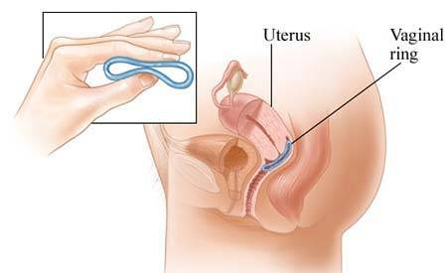
VAGINAL RING
Delivers low doses of oestrogen and progesterone.
Suppresses ovulation and thickens cervical mucus.
Inserted into the vagina.
It is inserted for 3 weeks and removed for 1 week, during which menstrual bleeding will occur. A new ring is then inserted.
Side-effects may include irregular bleeding, nausea, sore breasts, headaches, bloating, mood swings.
Perfect use = 99% effective, typical use = 93% effective.
Does not prevent STI’s.
Notes:
NOT INCLUDED IN THE TABLE IN THEIR BOOK.

Slide 24
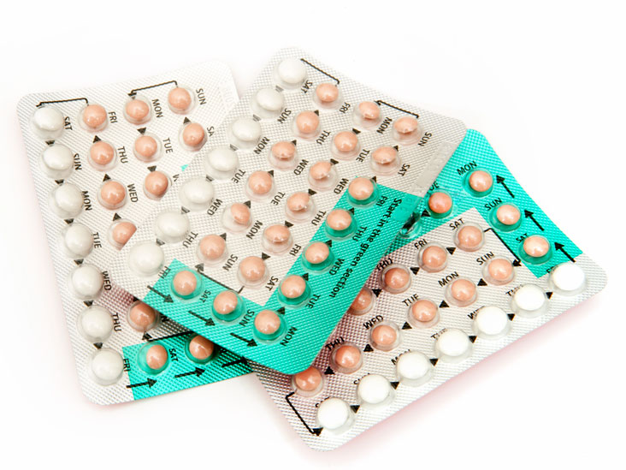
COMBINED PILL & Mini Pill
A pill taken daily that contains hormones.
Combined Pill = Oestrogen AND Progesterone, Mini Pill = Progesterone.
Works in 3 ways:
Temporarily prevents ovulation.
Temporarily thins the lining of the uterus, preventing implantation.
Thickens cervical mucus to prevent sperm entering the uterus.
Must be taken every day. If it is forgotten, it can result in an unplanned pregnancy if sexual intercourse occurs.
A hormonal pill is taken daily for 3 weeks, and in the 4th week a sugar pill is taken, and this allows for menstrual bleeding to occur.
Effectiveness of the pill can be affected by severe vomiting, diarrhoea, or with antibiotics.
It can help make periods regular, can improve acne, can help manage other painful menstruation symptoms.
Side-effects may include weight gain, mood swings, nausea, bleeding, blood clotting, ovarian cysts, depression.
A prescription is needed for the pill.
There are many options of the pill available with different hormone dosages.
Perfect use = 99% effective, typical use = 91% effective.
Does not prevent STI’s
Notes:
Combined pill – contains two hormones (progesterone and oestrogen) and prevents ovulation.
Mini pill – contains progesterone only and works by changing the mucus of the cervix so that sperm cannot pass through.

Slide 25

GLOSSARY: (pg. 8)
Barrier Method:
Puts a barrier between the penis and the vagina and stops the sperm from meeting the egg.
Hormonal Method:
Regulates or stops ovulation and so preventing pregnancy.
At the front of your books is your glossary.
Turn to your glossary and add the following words and their definitions:

Slide 26
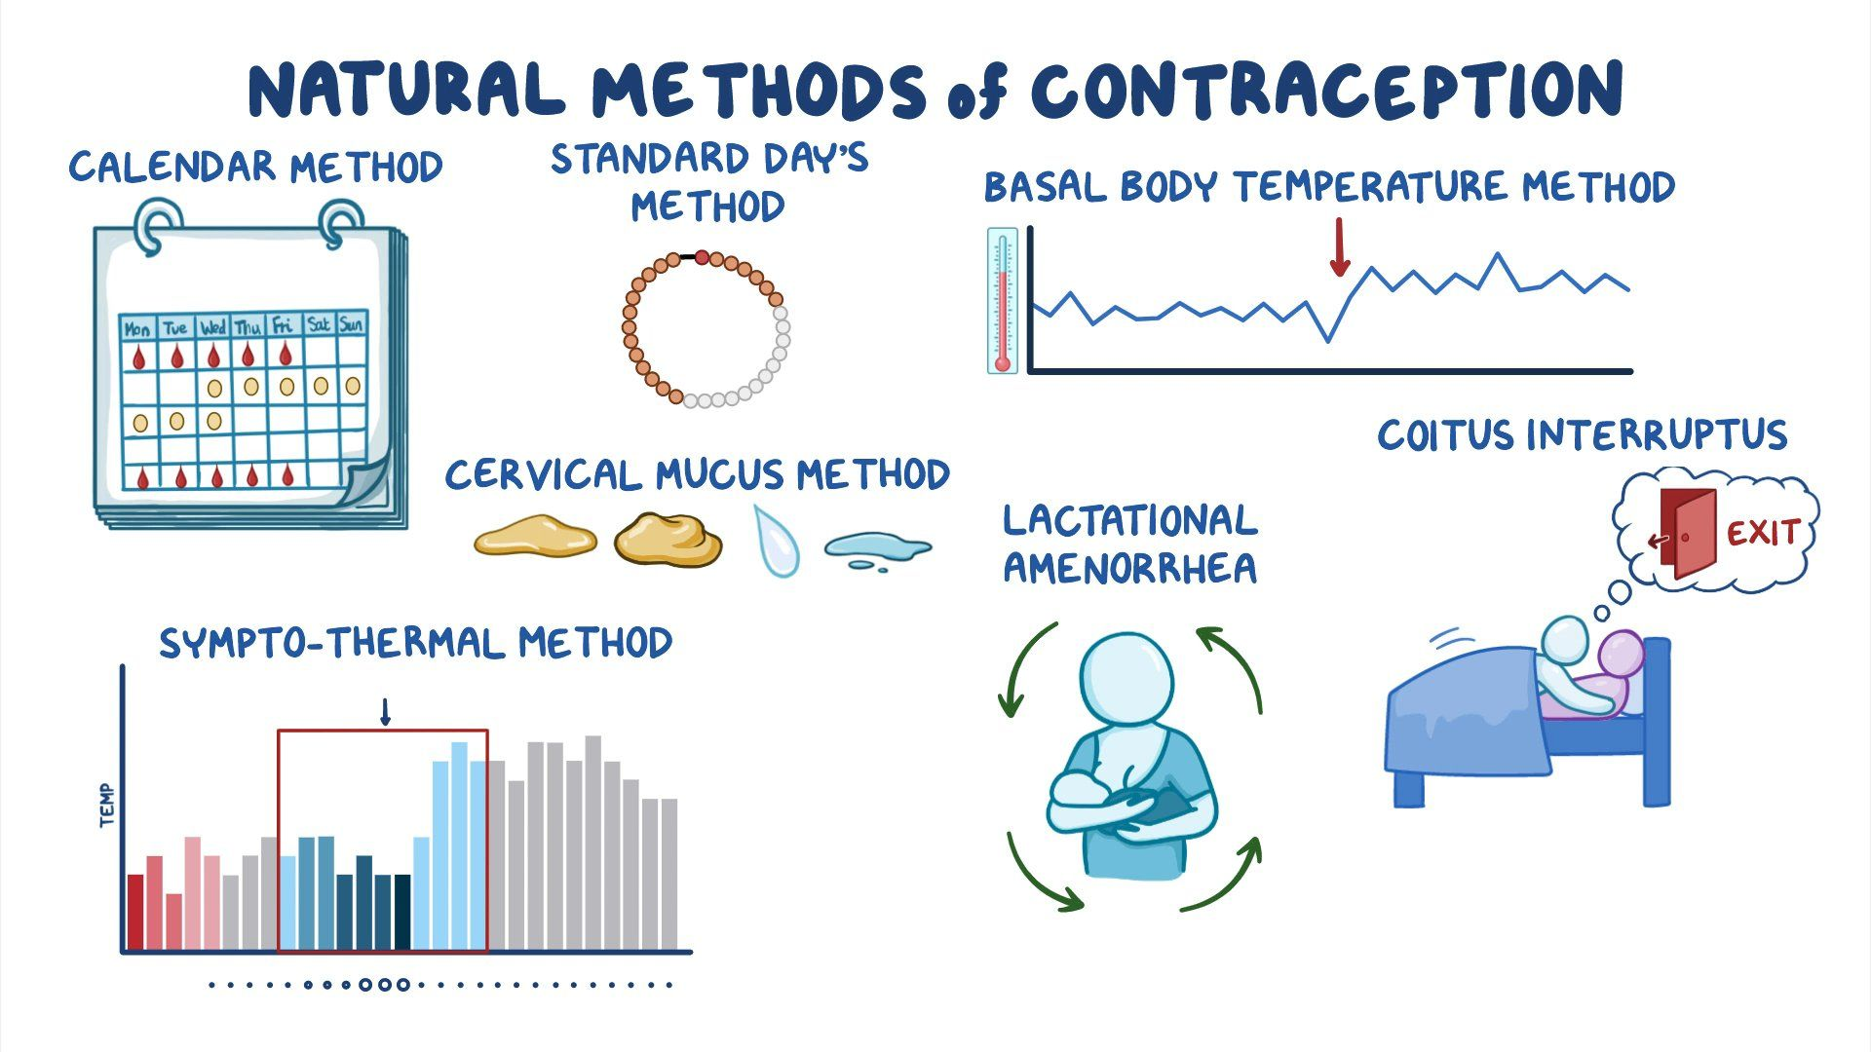
NATURAL METHODS:
Calendar (Rhythm Method)
Basal Body Temperature
Cervical Mucus
Ovulation Awareness
Withdrawal
Abstinence

Slide 27
Natural Methods
Involve finding out when a woman is at her most fertile so she can be extra careful or avoid sex all together during these times.
A combination of techniques is recommended for increased effectiveness.
Methods include:
Calendar (Rhythm) method
Basal body temperature
Cervical mucous method
Ovulation awareness method
Withdrawal

Slide 28
Rhythm Method
Used for females only with regular menstrual cycles.
This is done depending on the exact knowledge of ovulation and avoiding intercourse during the ovulation days.
For example: in a regular period that occurs every 28 days, ovulation should take place on day 14, so intercourse should be avoided 4-5 days before and after ovulation.
Ovulation can be detected by:
Basal body temperature – Increased body temperature by approx. 0.5 C
Cervical mucus – Change in type of cervical mucous
Ovulation awareness - Using an ovulation kit which can measure the amount of LH hormone present on that day.
There are apps available that allow women to track their menstrual cycle, body temperature, predicted ovulation etc.
Perfect use = 95% effective, typical use = ~75% effective.
Does not prevent STI’s.
Notes:
Apps include Apple Health App, Cycles, Flo - some have free services, others have subscriptions available.

Slide 29
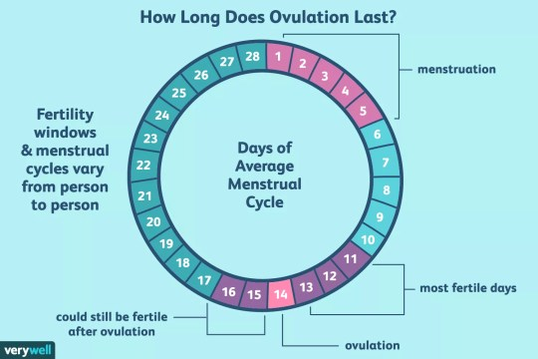
Fertility windows are different for every person, and it does rely on a regular menstrual cycle, so it is still important to exercise caution if a person does not want to get pregnant.
While uncommon and the chances are lower, a person can still fall pregnant while on their period.

Slide 30
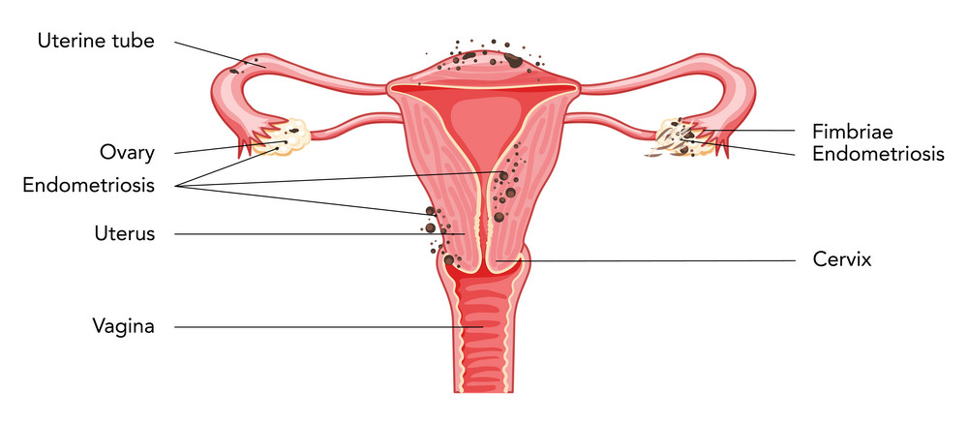
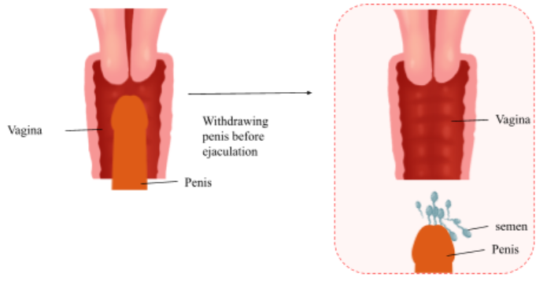
Withdrawal
A.K.A. Coitus Interruptus or ‘pulling out.’
The withdrawal/removal of the penis from the vagina before ejaculation occurs.
Relies on timing and self-control.
Still a chance of pregnancy as pre-ejaculate (the fluid before ejaculation) can contain sperm.
Perfect use = 96%, typical use = 78%
Does not prevent STI’s.

Slide 31
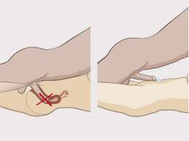
Pre-ejaculate can still contain semen, meaning there is still a chance pregnancy could occur.
If using the withdrawal method, it is important for the ejaculate to be away from the vulva/vaginal opening.
Withdrawal method can be partnered with a hormonal method.
Notes:
OPTIONAL to show this image with your class. Gauge your classes maturity level.
Can use this slide to discuss the importance of withdrawal not occurring near the vulva/vagina. Pre-ejaculate can still contain semen which means it can still lead to pregnancy so if the withdrawal method is being used, it is important to withdraw/pull out away from the vaginal opening.
Withdrawal method can be partnered with other hormonal contraception.

Slide 32

ABSTINENCE
Not engaging in any kind of sexual contact or behaviour.
100% effective (the only method).
STI prevention.

Slide 33
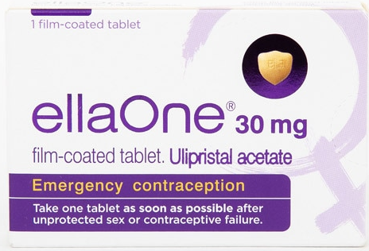
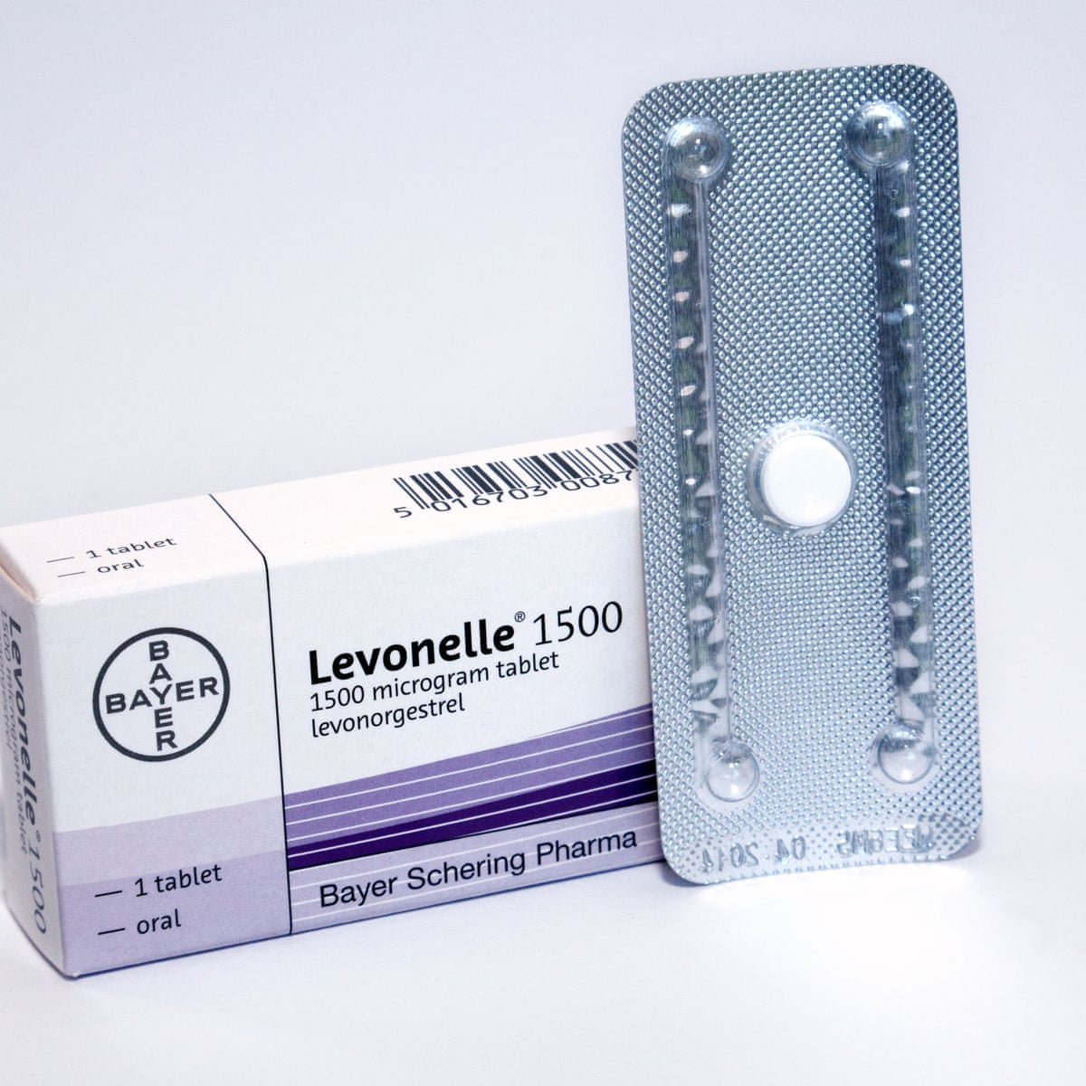
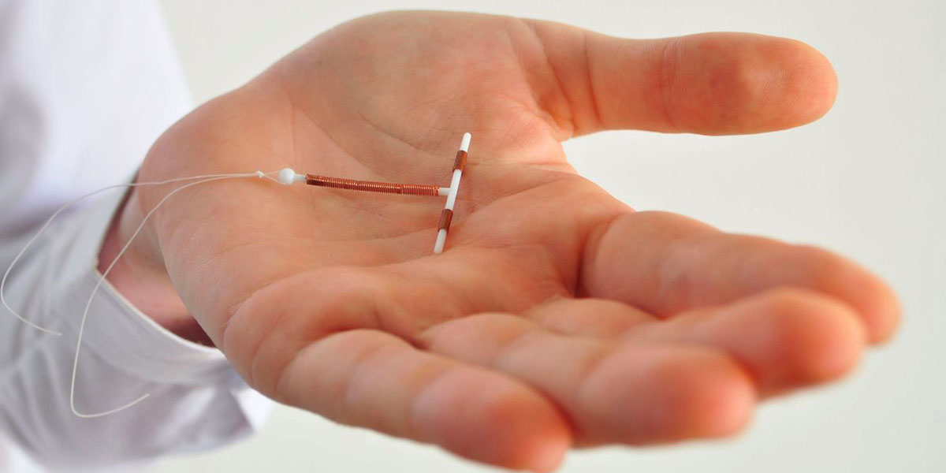
EMERGENCY METHODS:
Emergency Contraceptive Pill/Plan B
Copper IUD
Notes:
Mention the copper IUD as an emergency method – can be inserted up to 5 days after having unprotected sex.

Slide 34
EMERGENCY CONTRACEPTIVE PILL / PLAN B
A.K.A. Morning After Pill.
A ‘one-off’ pill taken ASAP after unprotected sex or where a contraceptive failure has occurred.
The sooner it is taken, the more effective it is in preventing pregnancy.
Available without a prescription.
Not to be used as a regular form of contraception.
Works by preventing or delaying ovulation.
Side-effects may include a heavier next period or have an early or later period, nausea, headaches, bloating, tender breasts.
85% effective (varies depending on when the pill is taken).
Does not prevent STI’s.
Notes:
Contraceptive failure = missed pill, condom malfunction (incorrectly used, slipped off, split)

Slide 35
Copper IUD - RECAP
T shaped device with copper wire.
Placed inside the uterus.
Toxic to sperm which prevents fertilisation, slows the movement of sperm and changes the lining of the uterus to prevent implantation.
They can last for 5 – 10 years (Long Acting Reversible – LAR method)
Can be used as an emergency contraception if inserted up to 5 days after unprotected sex.
99% effective.
Does not prevent STI’s

Slide 36
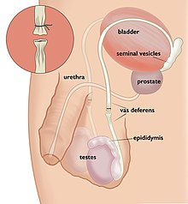
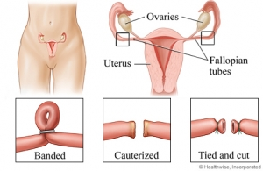
SURGICAL METHODS:
Tubal Ligation (female sterilisation)
Vasectomy (male sterilisation)

Slide 37
Tubal Ligation
A.K.A. Female sterilisation or getting ‘tubes tied’.
A surgical procedure where the fallopian tubes (the tubes that carry the eggs from the ovary to the uterus) are cut or tied.
Prevents the egg entering the uterus and therefore a sperm meeting an egg.
Permanent**
Menstrual bleeding will still occur monthly.
99+% effective.
Does not prevent STI’s.
Notes:
99+% effective – if in some way the tubes become unblocked, then there is still a chance of pregnancy.
** Usually permanent – depending on how the procedure occurs, and the age of the female, there could be room for reversal. If reversed, there is a higher chance of ectopic pregnancy.
Pregnancy can still happen via IVF if a person changed their mind about having children.

Slide 38
Vasectomy
A.K.A. Male sterilisation or ‘the snip.’
A surgical procedure where the vas deferens (the tube that carries sperm from the testes to the penis) is cut.
Effective 3 months after the procedure.
Permanent**
99+% effective.
Does not prevent STI’s.
Notes:
**Reversal procedure does not always work, and fertility may not be regained.
IVF is still possible as the testes continue to produce sperm. If sperm was not stored before the procedure, it may be possible for sperm to be retrieved with a minor procedure.

Slide 39
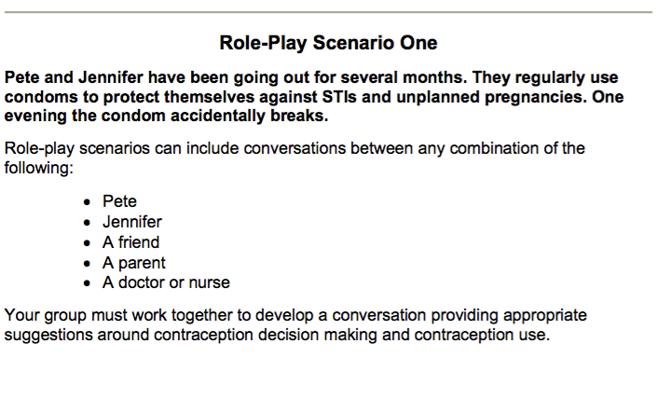
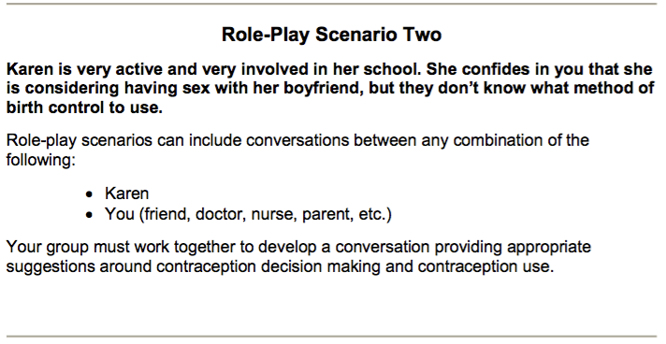
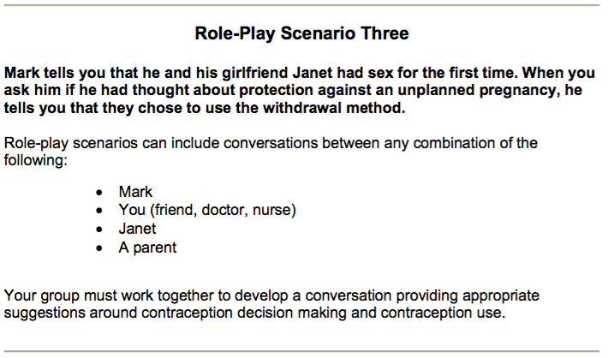
Activity 3: contraception scenario’s Which is best and why? (pg. 17)
Students will work in small groups or pairs.
Each group will be given a scenario card.
Read the scenario and decide on the best method/s of contraception to use in that situation for the people involved.
Notes:
RELEVANT TO TEST.
Resources available in health storeroom.
Ways to complete this activity:
As role plays:
Students work in small groups and perform the scenario card as a role play acting out the scene and contraception discussion.
Complete the scenarios in their books:
In their workbooks, three scenarios have been included. Students can spend time responding to the questions on their own. Discuss answers as a class.
Can also be completed as a reflection/revision activity.
THREE different scenarios are included in their workbooks to encourage them to consider different methods of contraception based on the scenario given.
Group → whole class discussions:
Students work in small groups and each group will be given a different scenario to discuss. Taking turns, each group will read out their scenario and their response to the rest of the class. Allow for whole class discussion.

Slide 40
Optional Activity 4: Contraception Kit
Use the contraception kit to show students the different methods of contraception.
Notes:
Resource available in Health Storeroom.

Slide 41
Optional Activity 5: Contraception Matching activity
Students are to work in small groups. Each group will receive a set of cards. Together, they need to match the contraception method to its correct pros and cons.
Notes:
Resource available in Health Storeroom.
Can be used as a revision activity.

Slide 42

REMINDER: TOPIC TEST NEXT WEEK
Complete your revision worksheet.
Notes:
Hand out revision
Any time remaining at the end of the lesson can be spent doing revision.
OR complete the previous activities and hand out revision as homework.

Slide 43
REMINDER!
As we talk through this unit on sexual health, it is important to acknowledge that no two people are the same.
Just as we all have different hair colour, skin colour, facial features etc., penis and vagina also vary greatly in shape, size and colour.
As with contraceptive methods – everyone has their own preferences for various reasons (i.e., cost, ease of use, length of effectiveness etc.) and everyone will react differently or have different side-effects (particularly for hormonal methods). This is also why there are so many options available.
There is no one perfect penis, vulva or method of contraception.

